Slide 1
Clustering Advanced Machine Learning
Data Science at Zindua School | By Chris Aloo

Slide 2
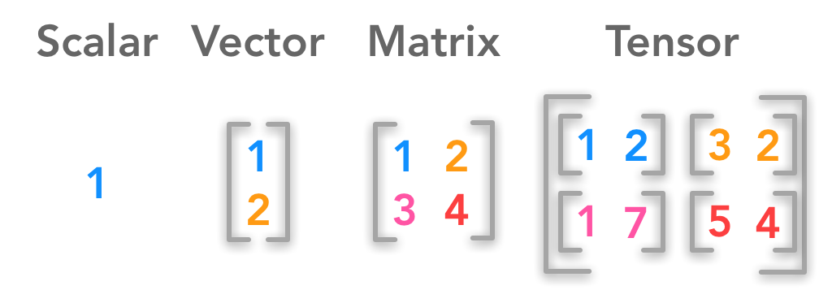

Brain Teaser
?
?

Slide 3
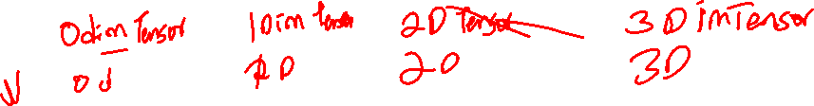
Brain Teaser

Slide 4
Introduction to Clustering

Slide 5
Introduction to Clustering
Unsupervised Learning Models
What is Clustering
Types of Clustering Models
Hierarchical
Partitioning
Applications of Clustering
Notion of Similarity/Distance
Statistical Distance
Semantic Similarity

Slide 6
What is Clustering

Slide 7
Types of Clustering Models

Slide 8
Application of Clustering

Slide 9
K-Means Clustering

Slide 10
Steps in the Algorithm

Slide 11
Steps in the Algorithm

Slide 12
Summary of K-Means Easy to use Need to know K May need to scale data Good initial method Local optima No guarantee of optimal solution Repeat with different starting values

Slide 13
K-means Lab

Slide 14
Hierachical Clustering

Slide 15

Key Concepts
Agglomerative vs Divisive – Desmond
Dendrogram – Desmond
Distance Similarity Matrix – Kipkorir
Linkage Criteria – Kiprorir

Slide 16
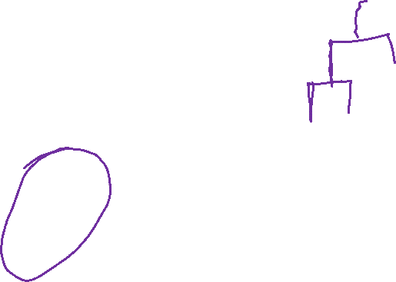
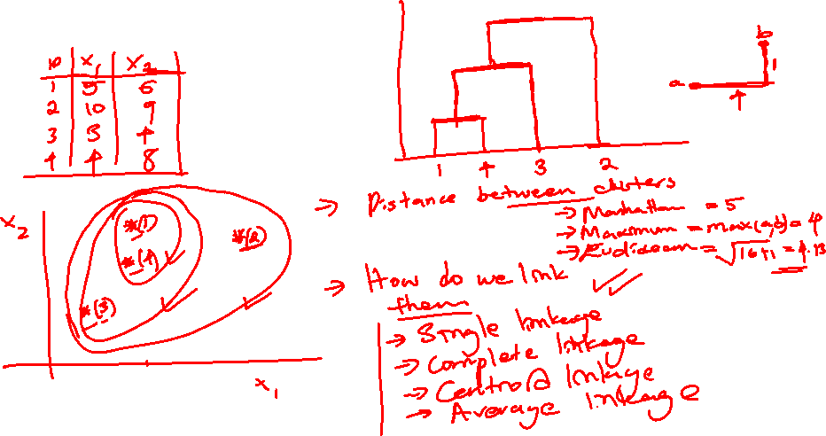
Hierarchical Clustering

Slide 17
Dendrogram

Slide 18
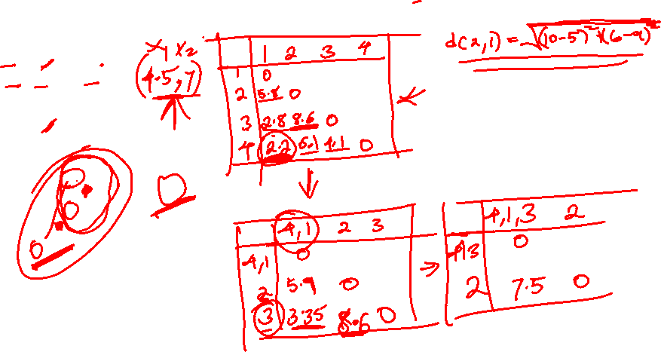
Distance Similarity Matrix

Slide 19
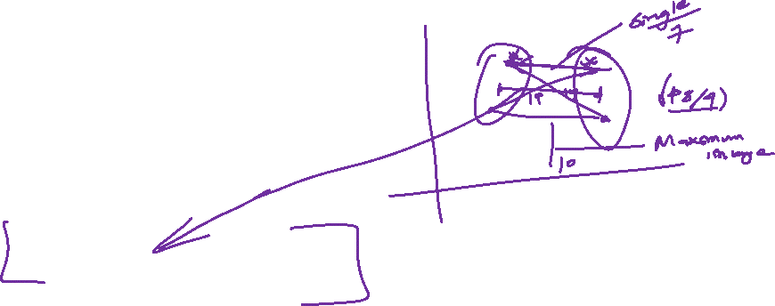
Linkage Criteria
Many variants to defining closest pair of clusters
Single-link
Similarity of the most cosine-similar (single-link)
Complete-link
Similarity of the “furthest” points, the least cosine-similar
Centroid
Clusters whose centroids (centers of gravity) are the most cosine-similar
Average-link
Average cosine between pairs of elements

Slide 20
Single Linkage
Use maximum similarity of pairs:
Can result in “straggly” (long and thin) clusters due to chaining effect.
After merging c_{i} and c_{j}, the similarity of the resulting cluster to another cluster, c_{k}, is:

Slide 21
Complete Linkage
Use minimum similarity of pairs:
Makes “tighter,” spherical clusters that are typically preferable.
After merging c_{i} and c_{j}, the similarity of the resulting cluster to another cluster, c_{k}, is:
C_{i}
C_{j}
C_{k}

Slide 22
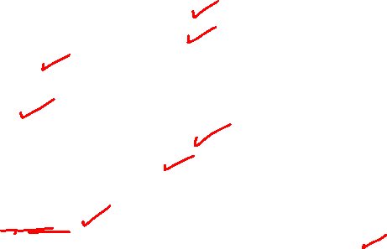
Summary of Hierarchical Clustering
Questions to ask
How do you calculate the distance between clusters
How do you tell which clusters are near each other
Which points do you use
Advantages
Easier to Implement
Do not require one to specify the number of clusters
Dendrogram can be used to understand results
Disadvantages
Not Efficient for Large Datasets
Does not produce results each time it is run, due to random initialization of centroids

Slide 23
Computational Complexity
In the first iteration, all HAC methods need to compute similarity of all pairs of N initial instances, which is O(N²).
In each of the subsequent N−2 merging iterations, compute the distance between the most recently created cluster and all other existing clusters.
In order to maintain an overall O(N²) performance, computing similarity to each other cluster must be done in constant time.
Often O(N³) if done naively or O(N² log N) if done more cleverly

Slide 24
Hierarchical Clustering Lab

Slide 25
Denisity Based Scan (DBSCAN)

Slide 26
Density-Based Clustering Methods
Clustering based on density (local cluster criterion), such as density-connected points or based on an explicitly constructed density function
Major features:
Discover clusters of arbitrary shape
Handle noise
One scan
Need density parameters
Several interesting studies:
DBSCAN: Ester, et al. (KDD’96)
DENCLUE: Hinneburg & D. Keim (KDD’98/2006)
OPTICS: Ankerst, et al (SIGMOD’99).
CLIQUE: Agrawal, et al. (SIGMOD’98)

Slide 27
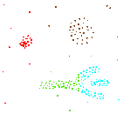
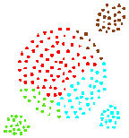
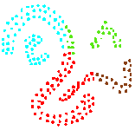
Density-based Approaches
Why Density-Based Clustering methods?
Discover clusters of arbitrary shape.
Clusters – Dense regions of objects separated by regions of low density
DBSCAN – the first density-based clustering
OPTICS – density-based cluster-ordering
DENCLUE – a general density-based description of cluster and clustering
Why Density-Based Clustering?
Results of a k-medoid algorithm for k=4

Slide 28
Density-Based Clustering Methods
DBSCAN is a density-based algorithm.
Density = number of points within a specified radius r (Eps)
A point is a core point if it has more than a specified number of points (MinPts) within Eps
These are points that are at the interior of a cluster
A border point has fewer than MinPts within Eps, but is in the neighborhood of a core point
A noise point is any point that is not a core point or a border point.

Slide 29
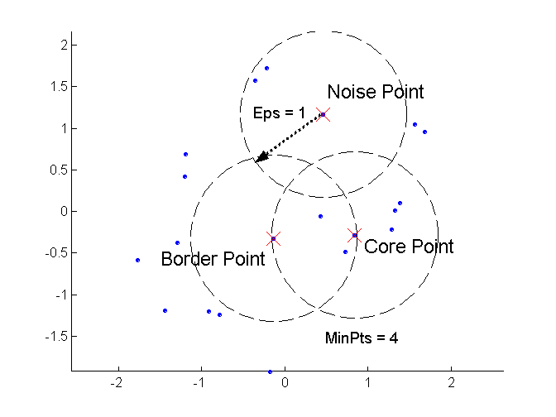
DBSCAN: Core, Border, and Noise Points
Outlier
Border
Core
ε = 1unit, MinPts = 5

Slide 30
DBSCAN Algorithm (simplified view for teaching)
Create a graph whose nodes are the points to be clustered
For each core-point c create an edge from c to every point p in the ε-neighborhood of c
Set N to the nodes of the graph;
If N does not contain any core points terminate
Pick a core point c in N
Let X be the set of nodes that can be reached from c by going forward;
create a cluster containing X∪{c}
N=N/(X∪{c})
Continue with step 4
Remark: points that are not assigned to any cluster are outliers;

Slide 31
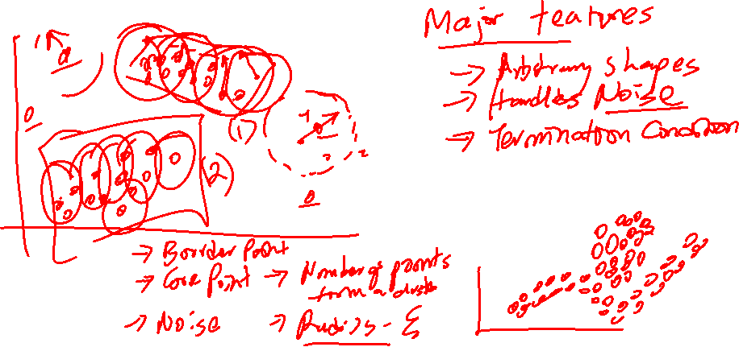
Steps in the Algorithm

Slide 32
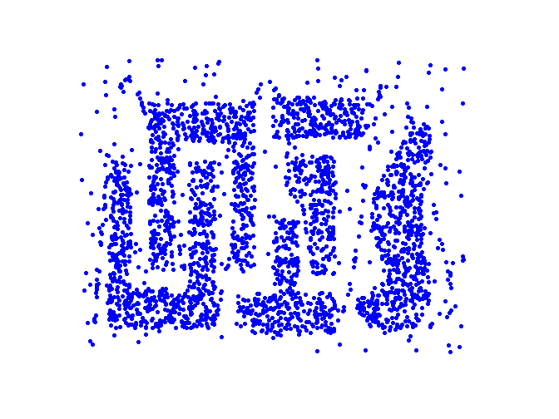
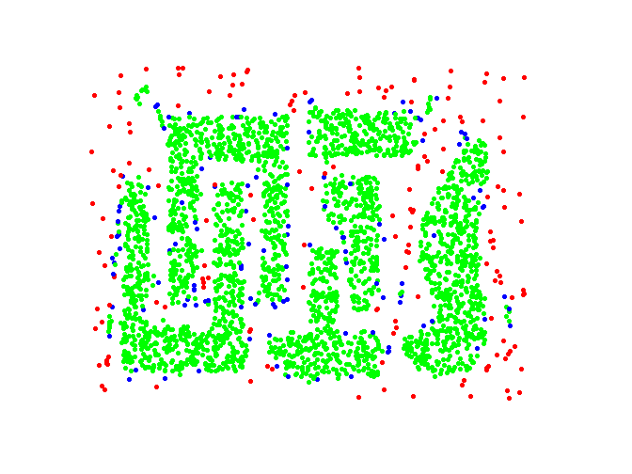
DBSCAN: Core, Border and Noise Points
Original Points
Point types: core, border and noise
Eps = 10, MinPts = 4

Slide 33
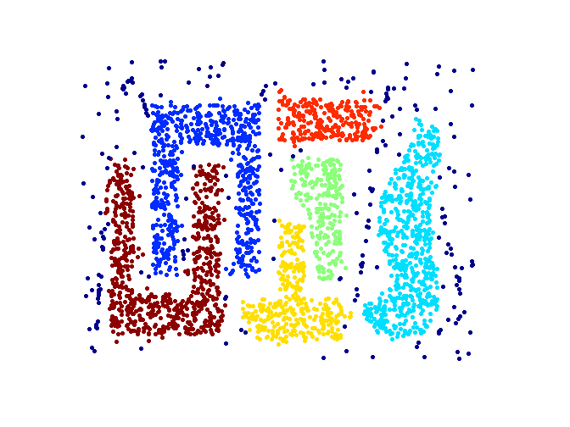
When DBSCAN Works Well
Clusters
Resistant to Noise
Can handle clusters of different shapes and sizes

Slide 34
When DBSCAN Works Well
Clusters
Resistant to Noise
Can handle clusters of different shapes and sizes

Slide 35
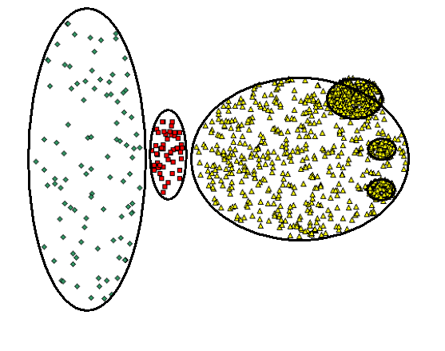
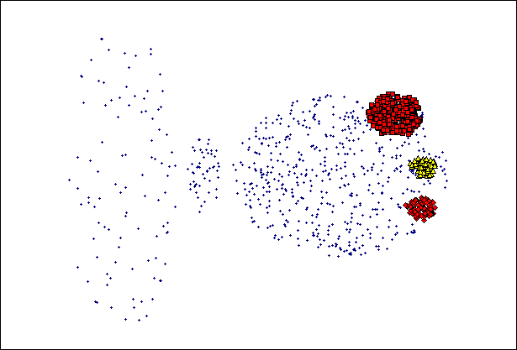
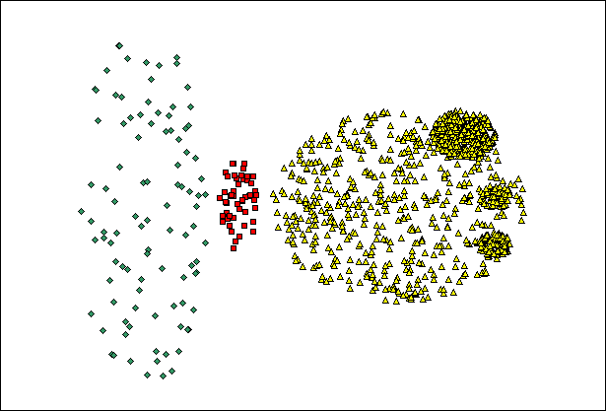
When DBSCAN Does NOT Work Well
(MinPts=4, Eps=9.75).
Original Points
(MinPts=4, Eps=9.92)
Varying densities
High-dimensional data

Slide 36
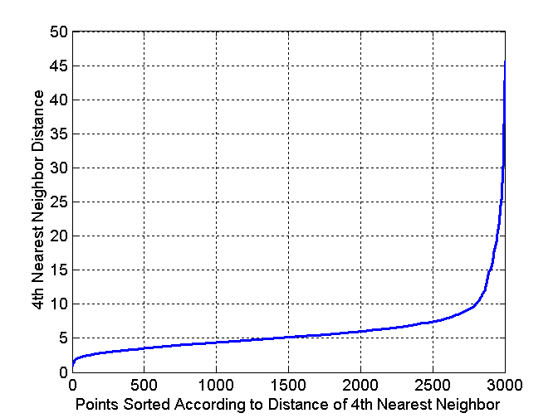
DBSCAN: Determining EPS and MinPts
Idea is that for points in a cluster, their k^{th} nearest neighbors are at roughly the same distance
Noise points have the k^{th} nearest neighbor at farther distance
So, plot sorted distance of every point to its k^{th} nearest neighbor
Run K-means for Minp=4 and not fixed
Core-points
Non-Core-points

Slide 37
Complexity DBSCAN
Time Complexity: O(n²)—for each point it has to be determined if it is a core point, can be reduced to O(n*log(n)) in lower dimensional spaces by using efficient data structures (n is the number of objects to be clustered);
Space Complexity: O(n).

Slide 38
Summary of DBSCAN
Good: can detect arbitrary shapes, not very sensitive to noise, supports outlier detection, complexity is kind of okay, beside K-means the second most used clustering algorithm.
Bad: does not work well in high-dimensional datasets, parameter selection is tricky, has problems of identifying clusters of varying densities (→SSN algorithm), density estimation is kind of simplistic (→does not create a real density function, but rather a graph of density-connected points)

Slide 39
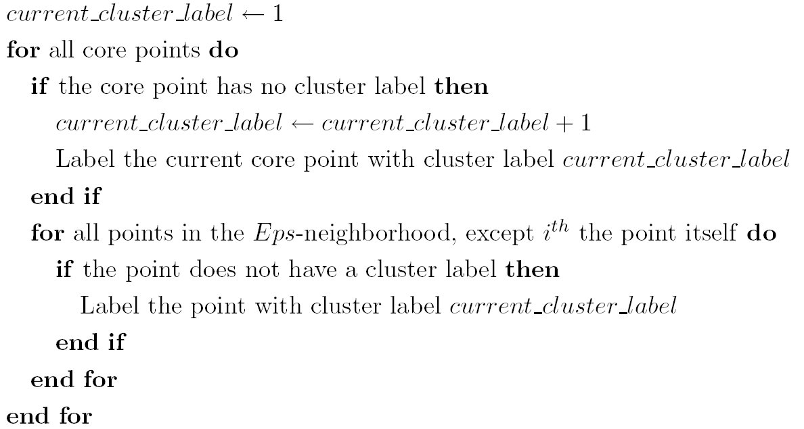
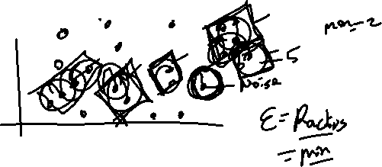
Summary of DBSCAN
Eliminate noise points
Perform clustering on the remaining points:

Slide 40
DBSCAN Lab
Check Out this Site for Implementation of DBSCAN with different shapes

Slide 41
Density Estimation

Slide 42
Key Concepts

Slide 43
Gaussian Mixture Models (GMM)

Slide 44
Key Concepts

Slide 45
When to Use GMMs

Slide 46
GMMs Lab

Slide 47
Clustering Performance Evaluation

Slide 48
Key Concepts

Slide 49
When to Use GMMs

Slide 50
GMMs Lab

Slide 51
End…

